Slide 1
Parallelizing Bayesian Deep Learning
Like a Gauss!
Pradeep Singh

Slide 2
Outline:
Traditional Neural Network
Bayesian Neural Network
Parallel Architecture
Tools
Code
Results

Slide 3
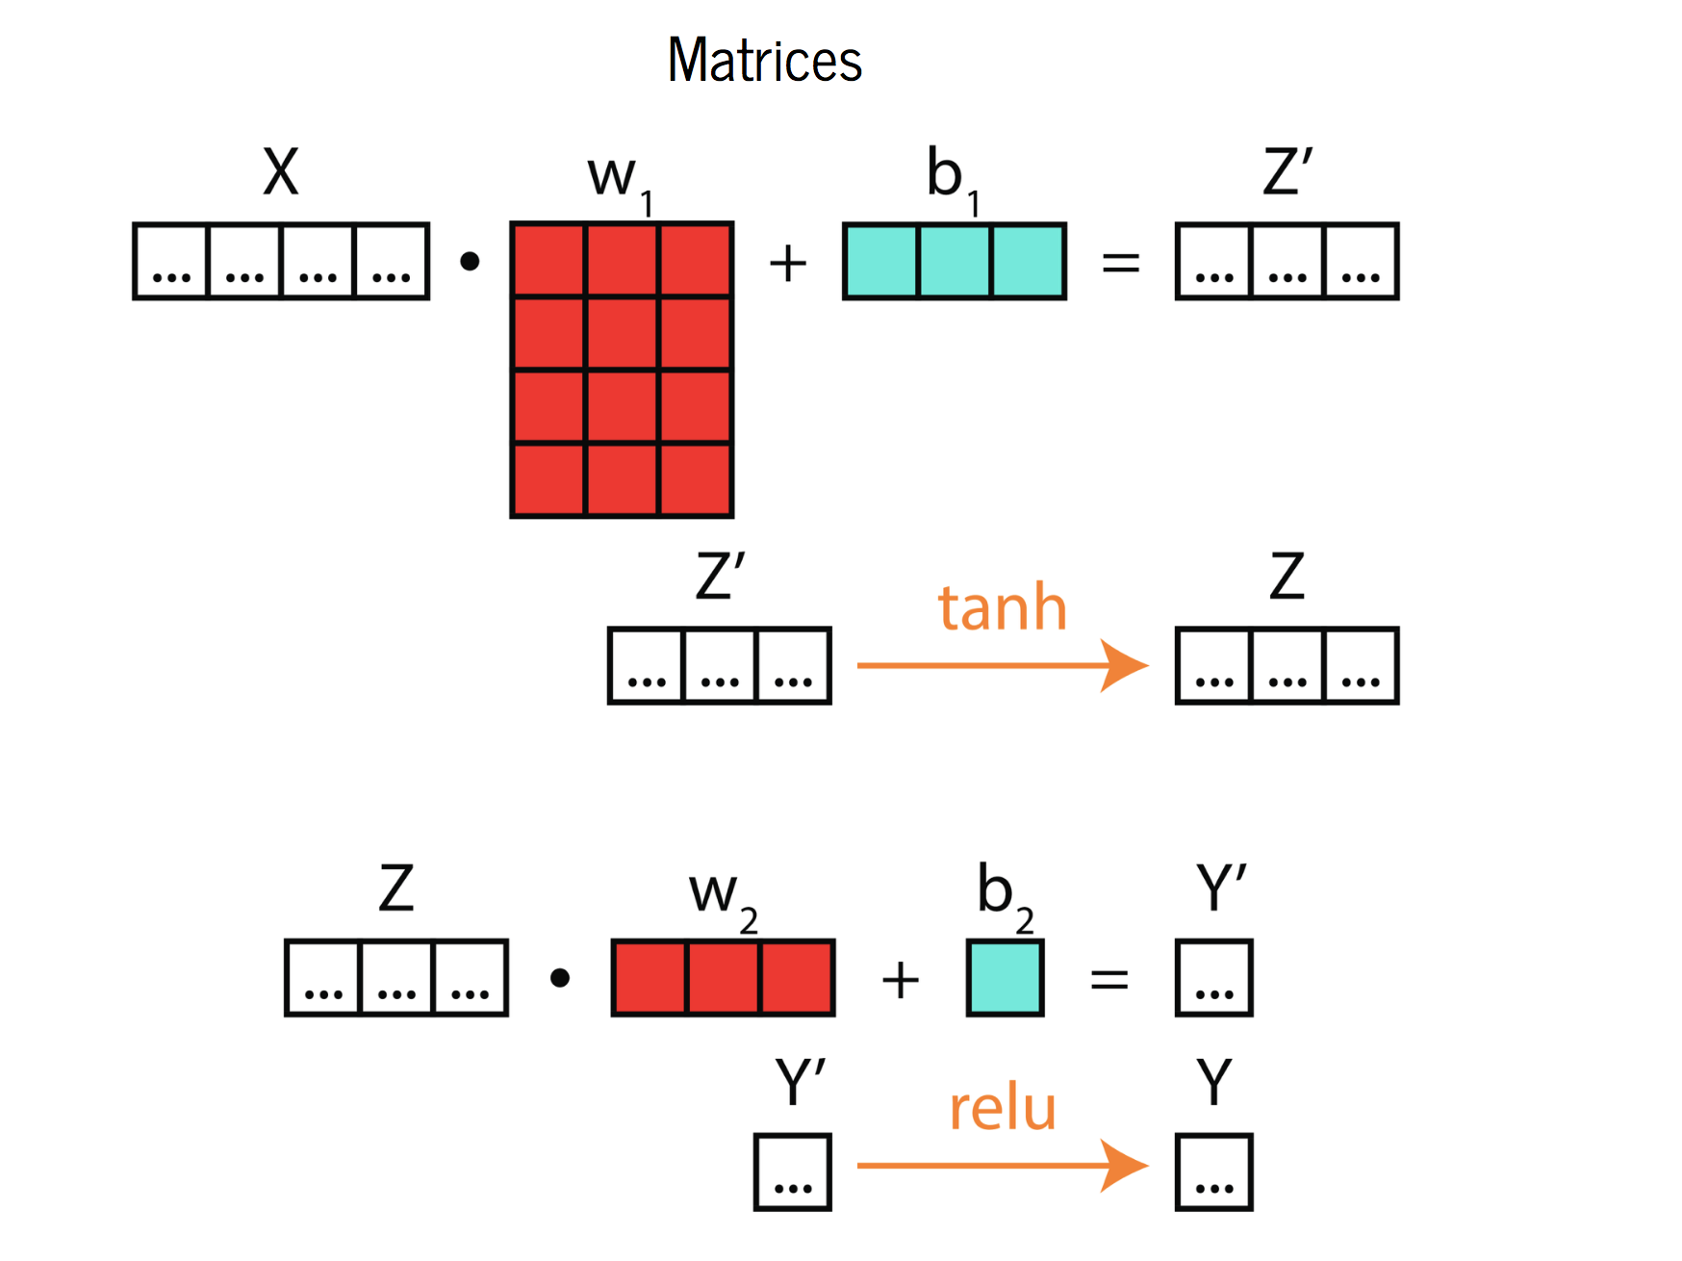
Neural Network
Source (Pictures): https://github.com/ericmjl/bayesian-deep-learning-demystified

Slide 4
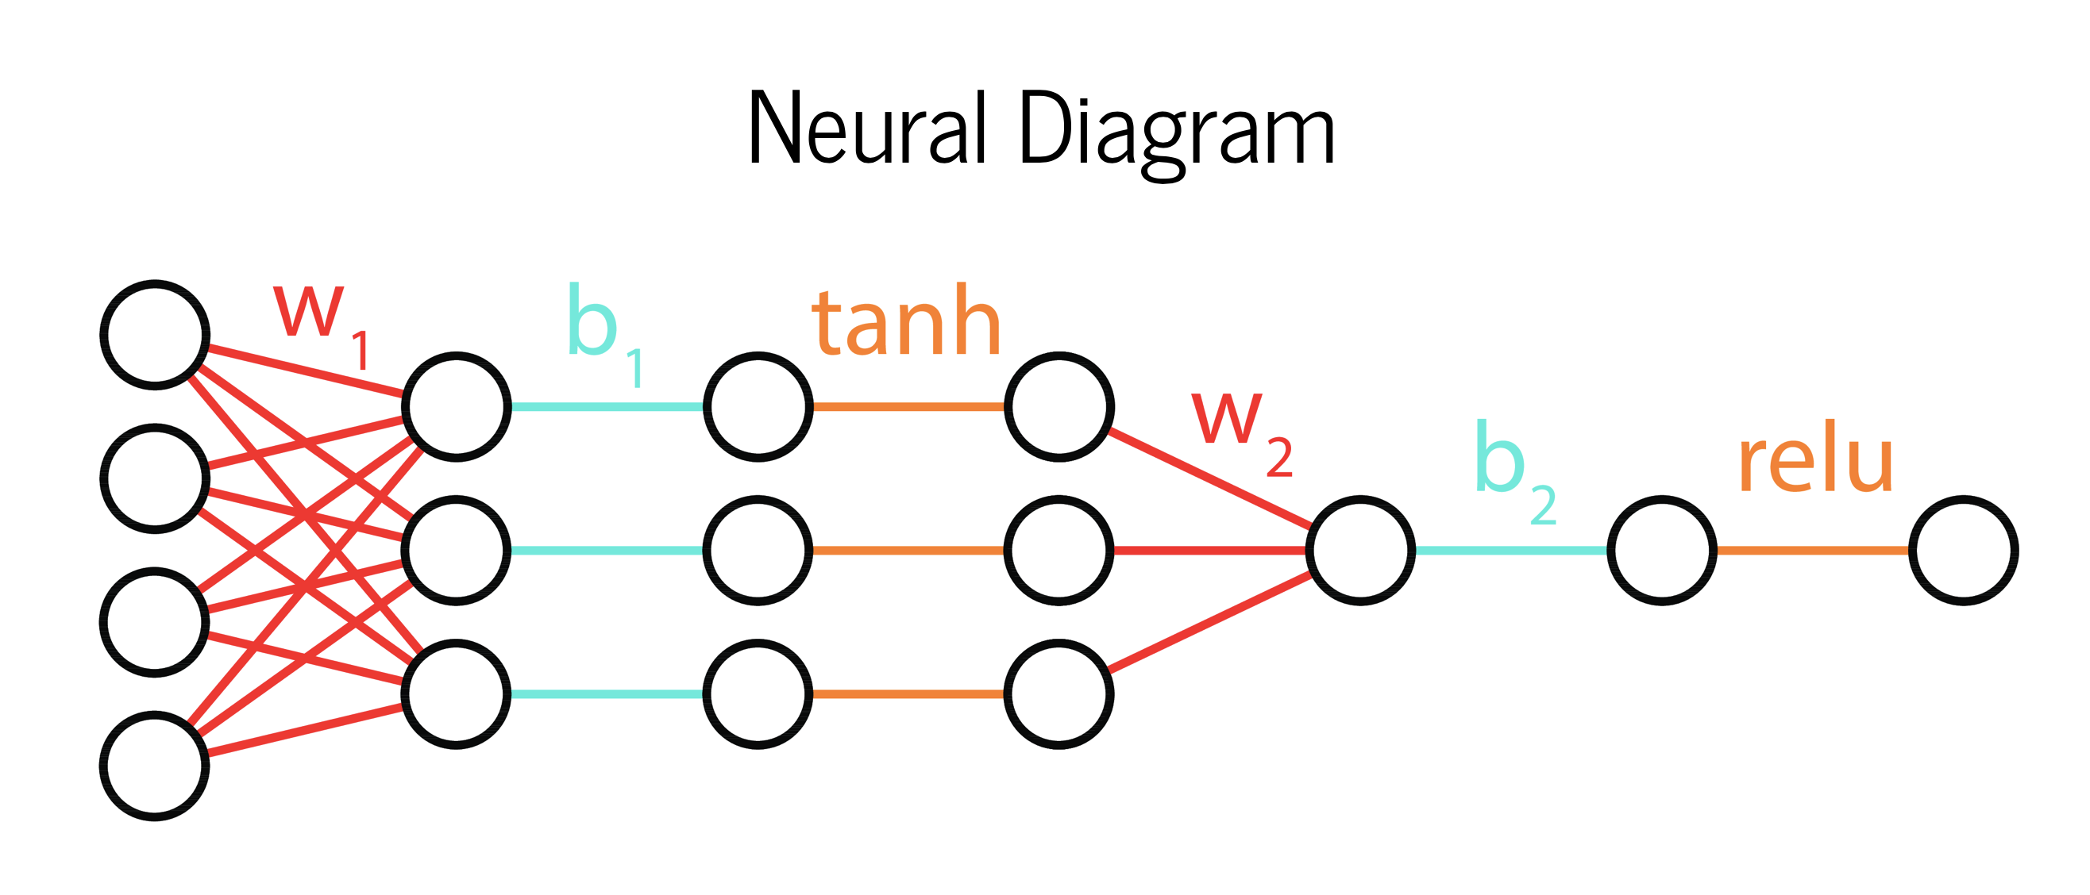

Slide 5
Going Bayesian…
Key Idea: Learn probability density over parameter space.
Treat your parameters (weights and bias) as Random variables.
With random variables you get expectation and variance.
Uncertainty propagates to the output.
Why do we need Uncertainty?

Slide 6
Traditionally neural networks are trained to produce a point estimate of some variable (of interest).
For example, we might train a neural network to predict stock in future using historical data.
Can you tell how much certain / uncertain our predication is?
No. (that’s why Neural Nets are also called Black Box)
By contrast, Bayesian neural networks enable us to estimate the uncertainty in our predictions using Bayes' rule.

Slide 7
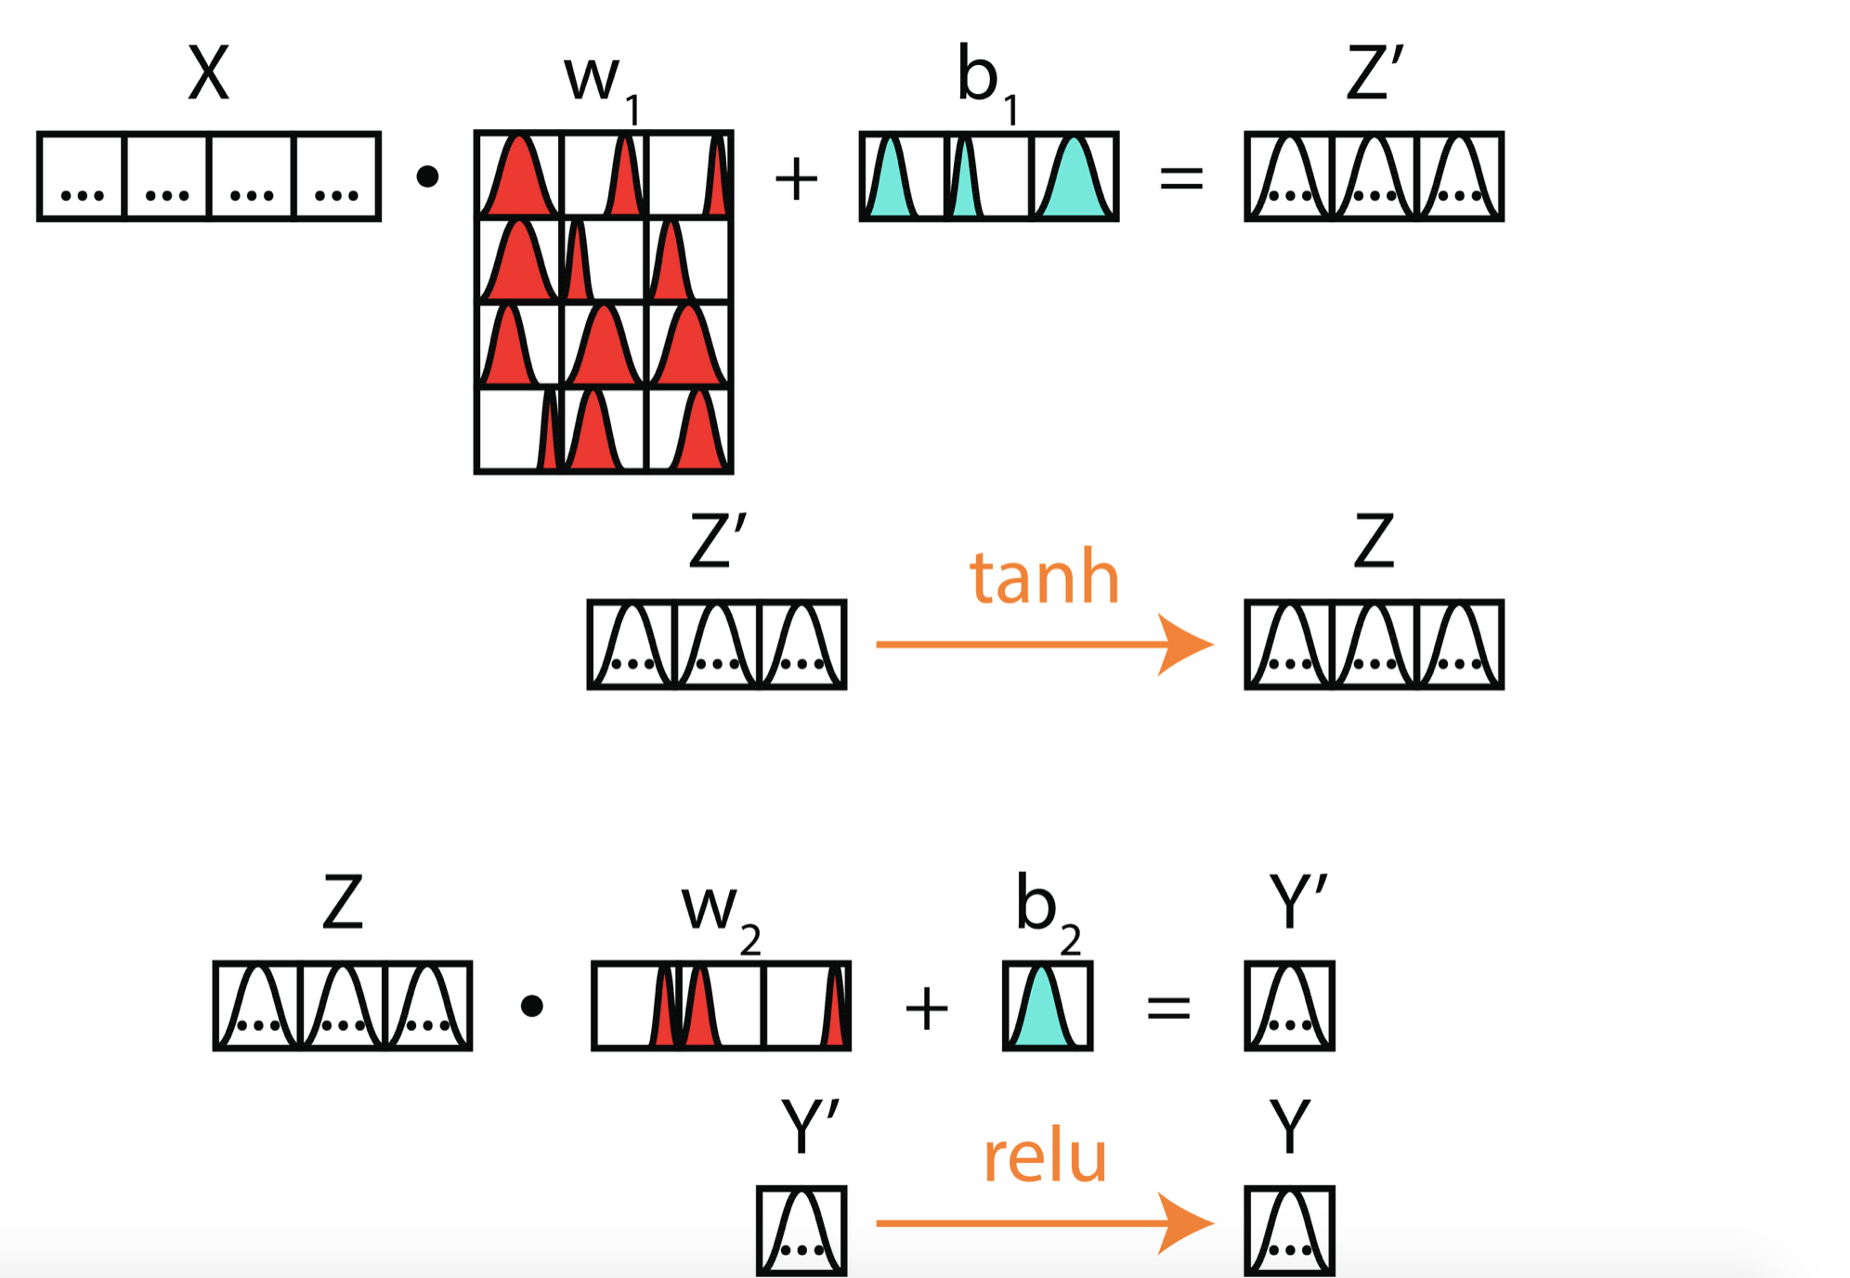
Learning a probability distribution for each parameter (weight & bias)
Source (Pictures): https://github.com/ericmjl/bayesian-deep-learning-demystified

Slide 8
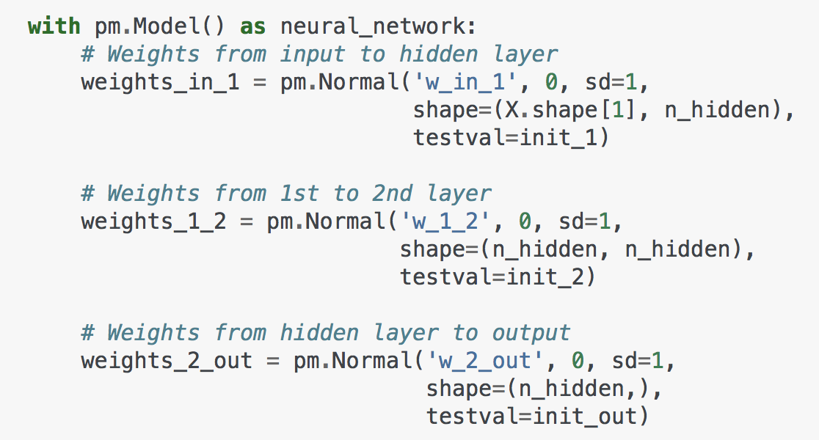
Probability distribution over parameters…
Normal prior with mean = 0 and SD = 1.
Source: https://github.com/pradeepsinngh/
Github Repo: parallel-neural-network-mpi

Slide 9
Parallelism: MPI + GPU (Data Parallelism)
Goal: To reduce training time.
Split the data in subsets.
Distribute the subsets to work nodes/ processes.
Collect the results computed by GPU.

Slide 10
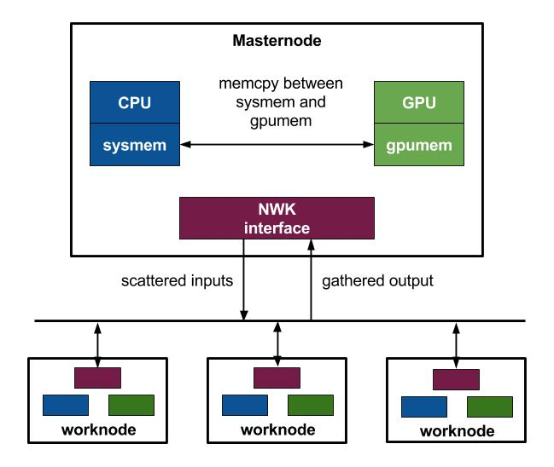

Slide 11
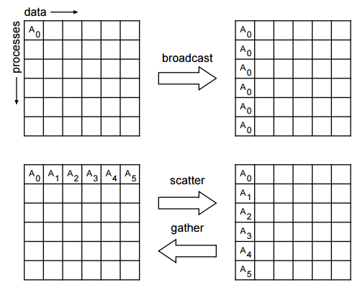
MPI standard -- distributed operations
Broadcast
Scatter
Gather

Slide 12
To distribute dataset to worknodes (Scatter) in mpi4py
Source: https://github.com/pradeepsinngh/
Github Repo: parallel-neural-network-mpi

Slide 13
To collect training results of worknodes (Gather) in mpi4py
Source: https://github.com/pradeepsinngh/
Github Repo: parallel-neural-network-mpi

Slide 14
To synchronize the weights of neural network among worknodes (Bcast) using mpi4py
Source: https://github.com/pradeepsinngh/
Github Repo: parallel-neural-network-mpi

Slide 15
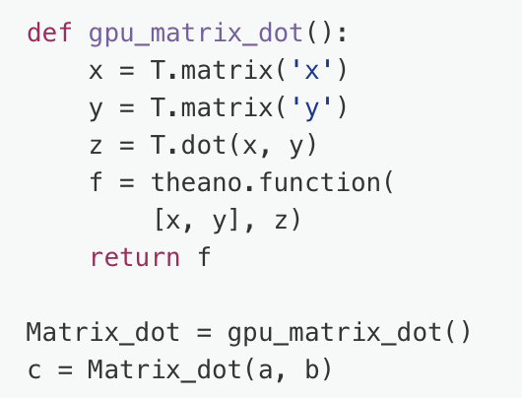
Matrix Multiplication on GPU -- Theano
Source: https://github.com/pradeepsinngh/
Github Repo: parallel-neural-network-mpi

Slide 16
Environment: Google Cloud
Zone: us-west1-b
Virtual Machine instance
Virtual CPU: (n1-standard-1)
Intel i7-5930 3.5 GHz
system memory: 3.75 GB
GPU: Nvidia Titan X
Numpy -- For matrix operations in CPU mode
Theano -- For matrix operations in GPU mode
mpi4py -- MPI for Python package.

Slide 17
Experiments:
Data parallelism vs Sequential execution: with CPU
Data parallelism vs Sequential execution: with GPU
The parameters of the learning algorithm:
learning rate: 0.1
gradient descent iteration: 60
activation function: sigmoid

Slide 18
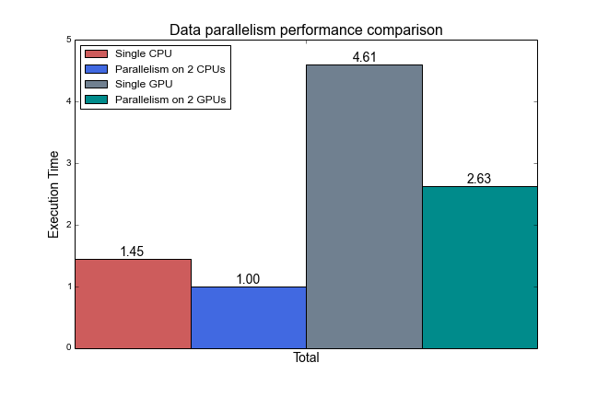
Results: Is CPU faster than GPU?

Slide 19
Observations: Is CPU faster than GPU?
No
Memory copy between system and GPU memory is expensive.
Size of the neural network is small so the computation loads are not really heavy.
Improvement in computing time by using GPU is overwhelmed by the time consumed while copying inputs and outputs between system memory and GPU memory.

Slide 20
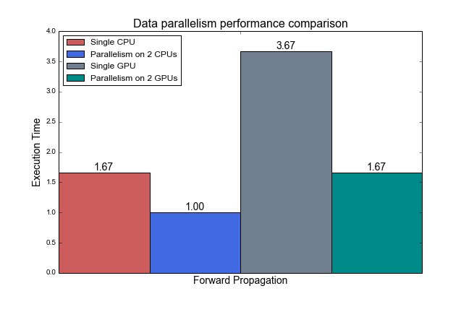
Time for Forward Propagation:

Slide 21
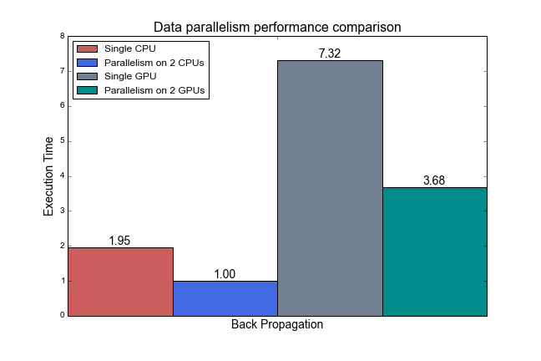
Time for Backward Propagation:

Slide 22
Plan for next week:
Implementation using MPI
Fit larger model
Use large dataset
Implement Bayesian methods using PyMC3
Implementation using PyCUDA
Parallize Neural network with Chainer (Deep learning framework)
Drop Bayesian part
Do some experiments

Slide 23
Thanks
Project Repo:
https://github.com/pradeepsinngh/parallel-neural-network-mpi

